Slide 1
Diversification, Ricardian Rents, and Tobin’s Q
Cynthia A. Montgomery and Birger Wernerfelt
RAND Journal of Economics
Vol. 19, No. 4 Winter 1988

Slide 2
Introduction
Prevailing theory → Firms diversify in response to excess capacity of factors that are subject to market failure
Goal → To extend this theory by considering the heterogeneity of factors
Main argument → The more widely a firm diversifies, the lower will be its average rents.
Empirical test → Tobin’s Q as the measure of economic rents

Slide 3
Ricardian rents
Rents Sources
Collusive relationships with competitors → Monopoly rents
Disequilibrium effects (luck) → Schumpeterian rents
Unique factors → Ricardian rents
Ricardian rents may be appropriated by owners of inimitable factors, or by their trading partners if relationship specific investments tie the parties together.

Slide 4
Diversification
A way to appropriate Ricardian rents
Factor has excess capacity and can be used beyond the firm’s current scope
If the factor is subject to market imperfections, firms can use capacity internally instead of selling or renting it.
Diversification

Slide 5
Diversification
The more widely a firm diversifies, the lower will be its average rents.
Closeness of the new market
Closest market = where the factor yields the highest rents
Distance to market increases as critical factors in it differ from those in firm’s current scope.
A firm will transfer excess factors to the closest market. If excess capacity remains, it will enter even more distant markets.
The more a firm must diversify, ceteris paribus, larger loss in efficiency and lower competitive advantage.

Slide 6
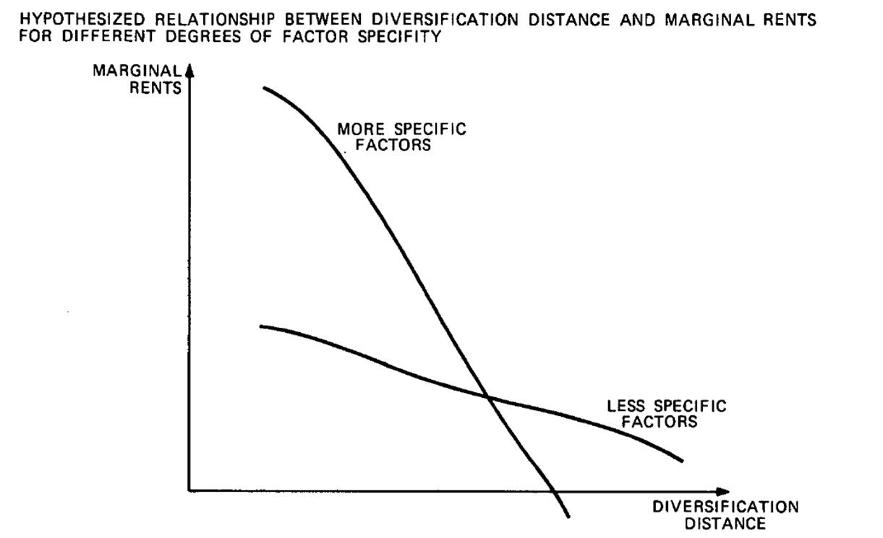
All things are not equal
Factors may vary in their specificity
Less specific factors: those that lose less efficiency as they are applied farther from their origin
Less specific factors support wider diversification → Their relatively lower value tends to strengthen the negative relationship between the extent of diversification and average rents.

Slide 7
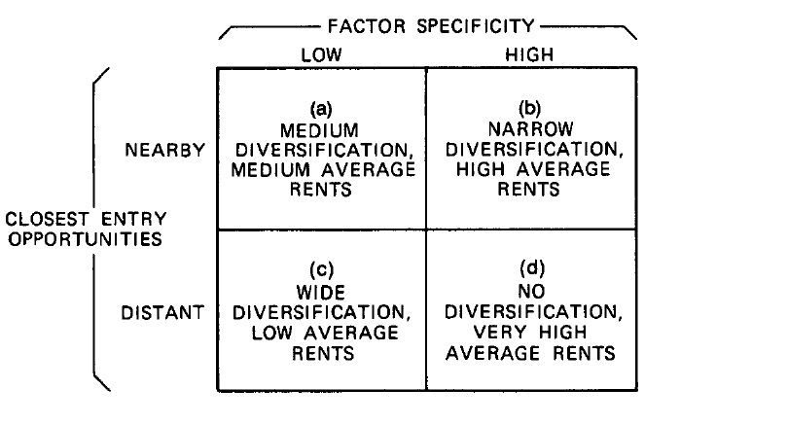
Optimal decision
The optimal decision is to apply excess capacity to the closest entry opportunity
As optimal diversification increases, average rents decline
The rent the firm can earn depends on factor specificity and closeness of the new market.

Slide 8
Tobin’s Q as a measure of rents
The use of accounting measures as a proxy for rents fails to consider differences in:
Systematic risk
Disequilibrium effects
Tax laws
Arbitrary accounting conventions
Pure-capital market measures capture only changes in firm value
(not levels of value)
Tobin’s Q → Appropriate measure as it combines capital market data with accounting data

Slide 9
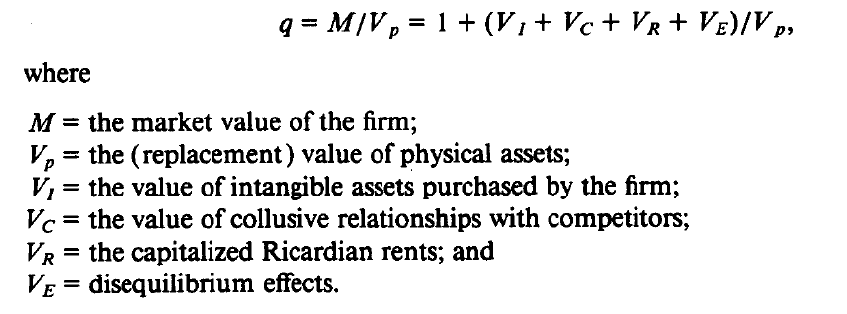
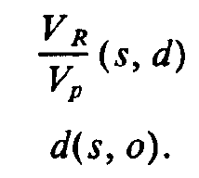
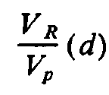
Tobin’s Q
The ratio of market value to the replacement cost of the firm
industry dummies as an instrument for d
(average industry-level diversification)
s and o are unobserved
VR/Vp is an increasing function of s and a decreasing function of d, while d is a decreasing function of s and an increasing function of o.

Slide 10
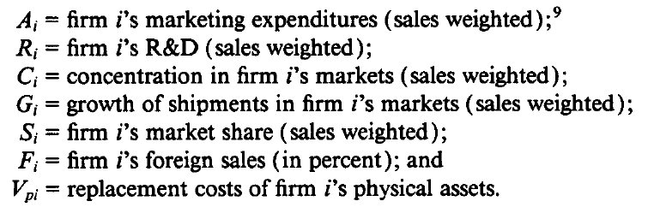
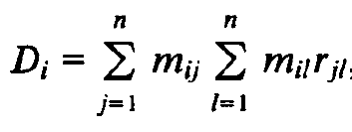
Data and Measures
Construct estimates of the following variables:
Diversification:
Di: vectors of dummy variables (one if firm i is active in two-digit industry j)

Slide 11
Data, Measures, and Tests
β0→ Value of q under perfect competition (Should be roughly one)
β1→ Coefficient of purchased intangible assets (Should be 10/3)
β2→ Coefficient of purchased intangible assets (Should be 10)
β3→ Coefficient of concentration (Unlikely to be significantly different from 0)
β4→ Coefficient of market share/indicator of Ricardian rents (Expected to be positive)
β5→ Coefficient of diversification ( Expected to be negative)
β6→ Coefficient of foreign sales (Hard to assess)
β7→ Coefficient of industry growth/captures disequilibrium effects (Expected to be positive)

Slide 12
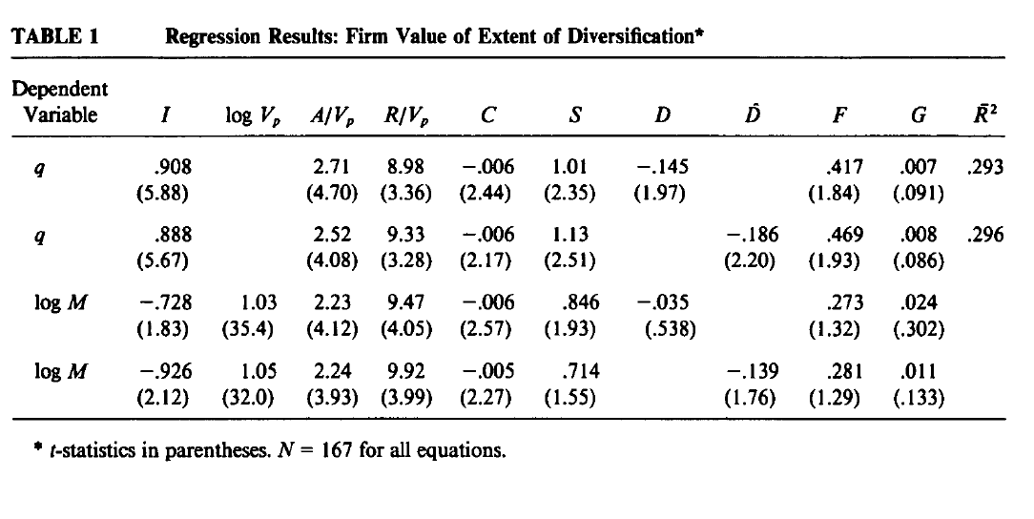
Results
Firms earn decreasing average rents as they diversify more widely.
This does not mean that diversification conflicts with value maximization.
Findings are consistent with the idea that diversification is prompted by excess capacity in rent-yielding factors that are subject to market failure

Slide 13
Empirical limitations
Higher Tobin’s Q captures not only Ricardian rents but also monopoly rents.
The study pertains only to large, successful firms, the theory is not expected to extend to small, competitive firms.
Both theory and tests refer to average rents, not total profits.

